Slide 1
Propensity Modeling Assignment

Slide 2

Agenda
Objective
methodology
Model Deep Dive
Some Numbers
Future work
Appendix

Slide 3
Objective
To build three propensity models (classification) to identify customers who are likely to buy
Credit Cards (CC)
Mutual Funds (MF)
Customer Loans (CL)
To also maximize the revenue from these clients

Slide 4
Methodology
Data Loading and Cleaning
We load the dataset first and clean the data.
Fill the NAs with 0
Convert any categorical variables to one hot encoded values (Sex)
Feature Selection
We generate a correlation matrix
We remove the features with high correlation – Remove 5 features

Slide 5
Methodology
Model Preparation
We split the data into training and test set with an 80/20 split
We train 3 models for the 3 products – CC, MF, CL
We also train 3 regression models to predict the revenue of the customers
We use KS Statistic to check the model discrimination and generate deciles to see the top deciles that capture the responders (Model Evaluation)

Slide 6
Methodology
Client Selection
Once we have all our predictions, we used the predicted probability to select the clients.
For each product, we used the top 15% of probabilities for choosing the clients (Based on the constraints given)
As there is a constraint to only offer 1 product to 1 client, we assess the overlapping clients to see which product to offer.
We do this by taking the maximum revenue possible across all products for that client.

Slide 7
Model Deep Dive
For propensity models, we develop 3 XgBoost models as –
They handle non-linear data
They are good at handling high-dimensional data
They work with missing data as well but we had already cleaned our data
For regression model, we develop 3 Linear Regression models as –
It is the simplest form of regression
It is interpretable
Training an XgBoost regressor would be an overkill

Slide 8
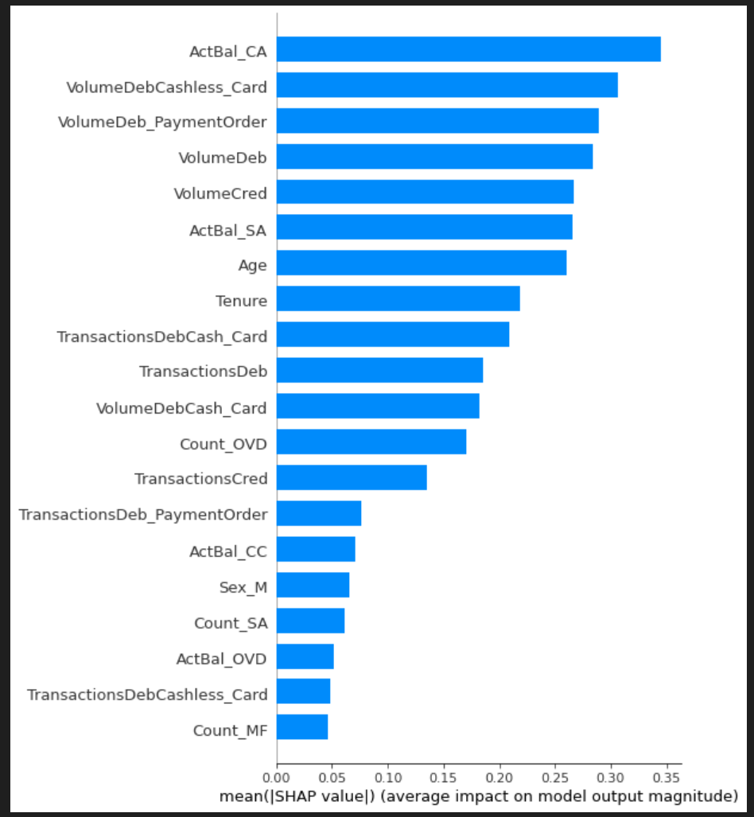
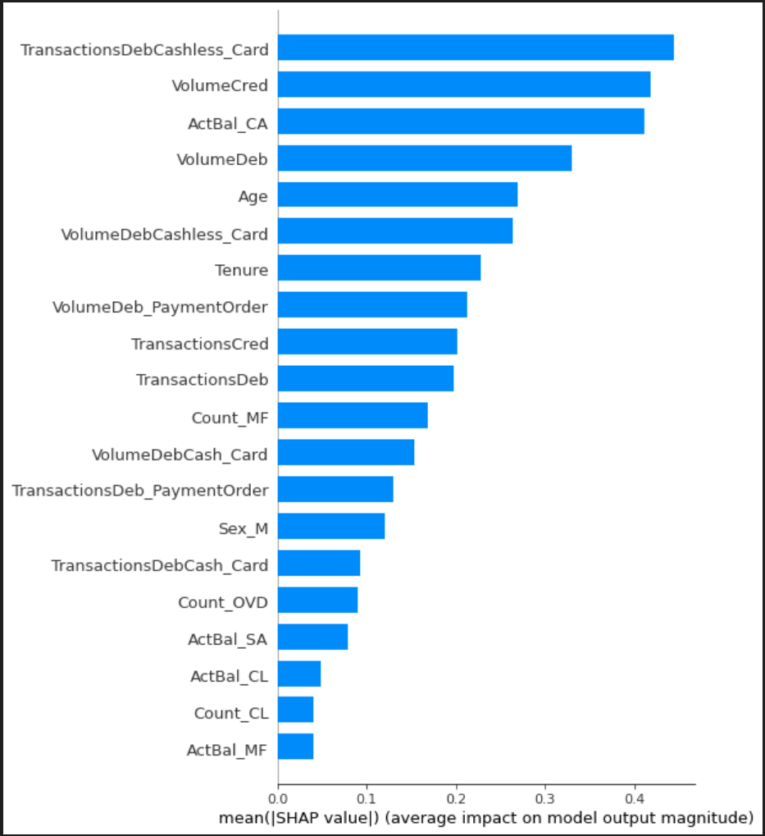
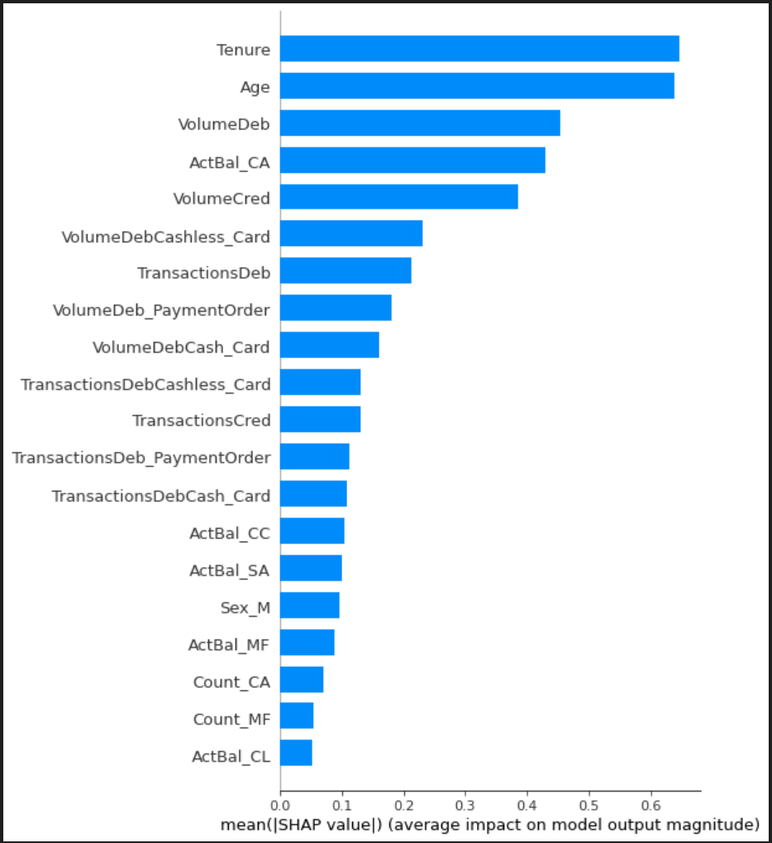
Model Deep Dive
We use SHAP to check the top contributing features for each model
Credit Card
Mutual Fund
Customer Loan

Slide 9
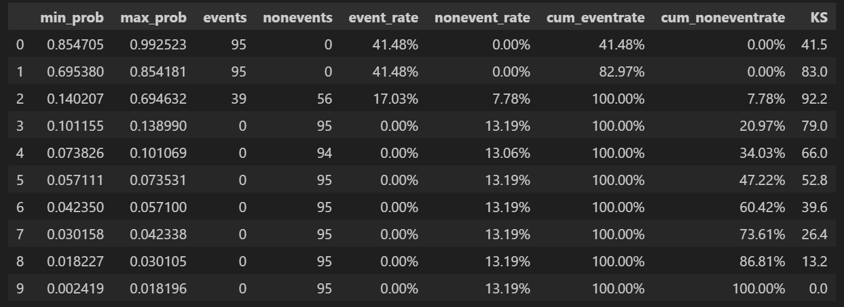
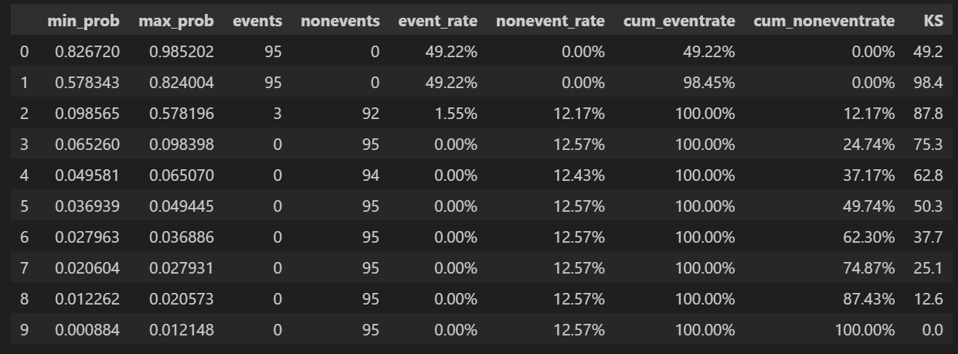
Model Deep Dive
Model Evaluation using KS Statistic
Training Set
Test Set
Based on KS Statistics and Deciles, for training set, top 3 deciles capture 100% of the events and is validated through the test set also.
However, 3 deciles capturing 100% is very idealistic (but we can make this assumption as the data may be synthetic)

Slide 10
Some Numbers
Total Customers Targeted - 359
Product | Customer Count (Predicted) | Actual Revenue (From Revenue_CC/MF/CL)
CC | 113 | 1741.71
MF | 118 | 1404.09
CL | 127 | 1640.52
Product | Customer Count (Predicted) | Predicted Revenue (From Regression model)
CC | 113 | 502.62
MF | 113 | 325.92
CL | 133 | 830.28

Slide 11
Future Work to improve the model
Use Variance Inflation Factor (VIF) and Information Value (IV) to further narrow down the features
To build a more accurate regression model

Slide 12
Appendix
Output file - Clients Selected by Actual Revenue
Actual Product – It is the product we select if we use the revenue from the given data (original revenue)
Actual Revenue – It is the original revenue from the data
Output file - Clients Selected by Predicted Revenue
Predicted Product – It is the product we select if we use the revenue from the regression model
Predicted Revenue – It is the revenue from the regression model

Slide 13
Thank you
Kartik Chopra
Kartik@u.nus.edu

